Slide 1
ACT
State Funded Reportable
Spring Reportable: 2/25/25
Notes:
Update contact list
Cost
*NOTES FROM LAST YEAR!
Talk about irregularity reports. Don’t invalidate a test just because a student misses the 2nd day of testing – ACT will score the part that he completed.
Notify us if you have any of these so that our numbers are correct when we verify the results
If the test administrator does not know the student you MUST verify the student’s ID!

Slide 2
Reminders
Test booklets will have administration type (Standard or ACT-Authorized Accommodated) on the front cover
All students must be listed in Pearson Access Next to test (issued an ACT ID)
Students must complete Pre-test information in MyACT prior to, or within 2 days after testing
ACT does not allow wearing of watches

Slide 3
Students to Test (Reportable)
Schools should offer reportable ACT to ALL enrolled grade 11 students (exceptions are those students who are ACCESS)
11th graders who also want to take ACT-NCR can take in the late spring window (3/11-3/14)
Must give parents an opt-out (template opt out letter in Google classroom)
Some schools will also test address zoned FLVS Full-time students

Slide 4
What’s New
Secure Destruction: Within 72 hours after testing, you should arrange for secure destruction of all forms (except the Testing Staff List, Scribe Agreements, Readers Agreements, and Interpreter Agreements which must be retained for one year)
Translated test directions: Available on ACT-hosted website
Answer Documents:
  No longer lists year.
  Examinees will now have an apostrophe to grid for their f/l name
Materials: All secure and non secure will ship together
Scribe/Reader/Interpreter agreements: On ACT-hosted website

Slide 5
Students to Test
Once Evaluation Services has uploaded eligible students, Scott will upload the spreadsheets into the shared drive
Do not edit this spreadsheet – we will send a blank template if you need to add students
You will use these spreadsheets to report after testing which students actually tested
  Scott will upload the extract 1 week prior to test date to ensure accuracy with student moves/promotions, etc

Slide 6
Students and Accommodations
For reportable ACT, ALL accommodations must be pre-approved by ACT.
Accommodated window is 2/25-2/28 and 3/3-3/7
For students served by IEP/504/ELL
Examples of designated supports include:
  Small group or one-to-one testing
  Food, drink, or access to medication, for examinees w/ medical needs
  A written copy of verbal instructions
  Using colored overlays
  Using magnification device (paper) (non-electric)

Slide 7
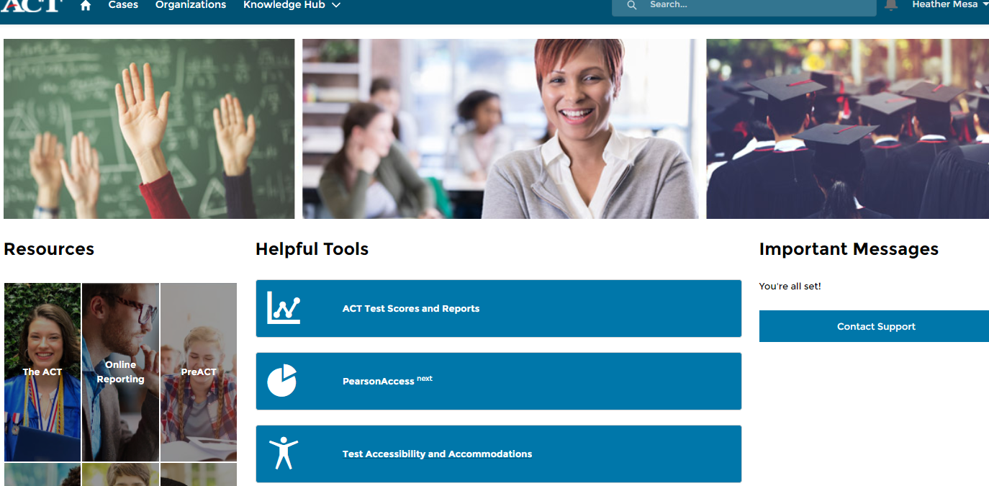
Students and Accommodations
ACTStateAccoms@act.org 1-800-553-6244 x1788

Slide 8
Accommodations
Search for State and District testing
Students can be “Approved”, “Partially Approved”, “Not Approved”, or “Action Required”
If a student is “Not Approved” or “Action Required”, you may click on the blue hyperlink (TAA PIN) and see what option are available
  Usually you can Edit for Reconsideration and Download Decision Notification to view why the student was denied
Once they are Approved, you can assign a test date under the student’s approval

Slide 9
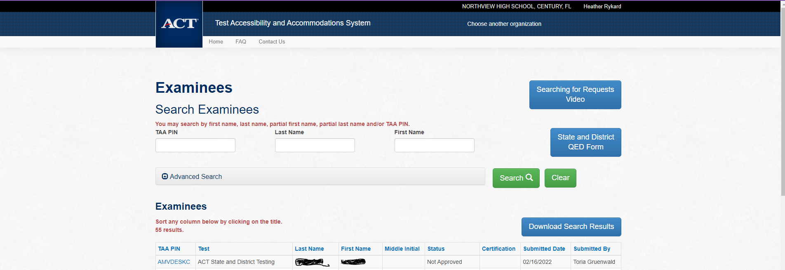
Accommodations

Slide 10
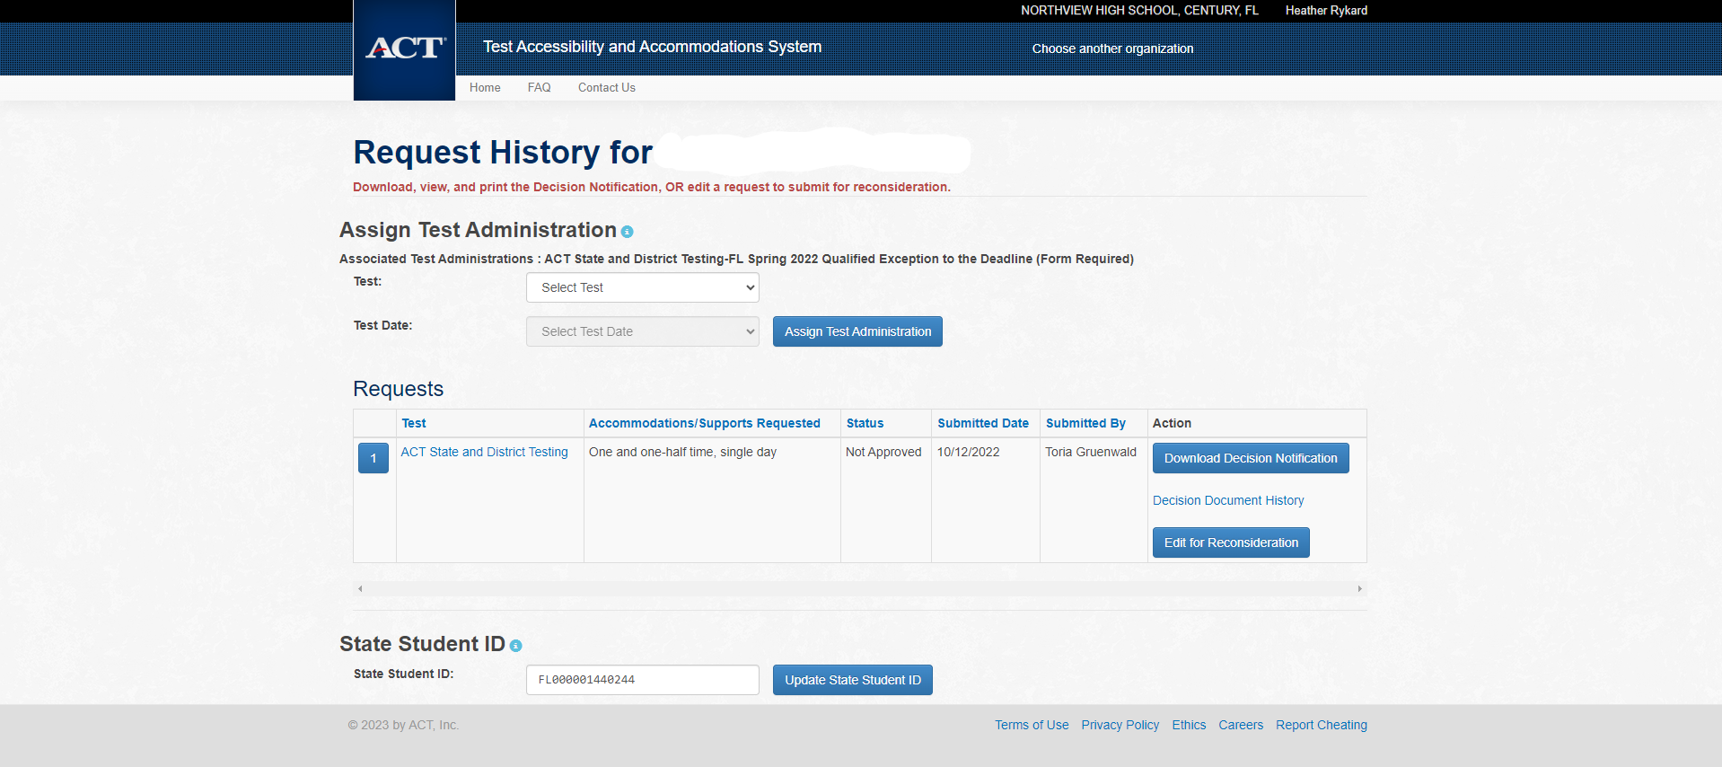
Accommodations

Slide 11
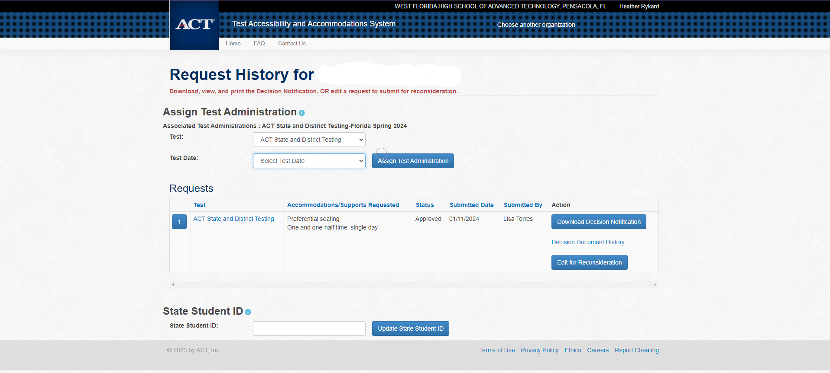

Slide 12
Preparation –
General
Receive and inventory Reportable materials within 24 hours. Keep your boxes for returning materials
Apply barcode labels to answer documents in designated area
  Recommend NOT applying barcodes ahead of time to account for absences, room moves, etc
Hand grid student information if you don’t have a label
Store materials securely
Train test administrators
Notes:
- ACT PAN site is different than our regular PAN site

Slide 13
Preparation -
Staff
Room supervisors and proctors may be current or retired faculty members, school admin or clerical employees, substitutes, student teachers, or paraprofessionals
May not serve as test coordinator if a relative is testing in the ACT window
Relative is: children, stepchildren, grandchildren, nieces, nephews, siblings, in-laws, spouses, and persons under your guardianship.
Staff must remain attentive to their testing responsibilities throughout the administration
Coaches may serve as a room supervisor, but may not supervise one-to-one testing for a student-athlete

Slide 14
Preparation –
Staff Training
School test coordinator is responsible for providing manuals, supplements, and training to all test site staff before test day.
Training needs to cover:
  Facilities (Room) requirements and set up
  Test Materials
  Non-Test Activities
  Test Administration
Test Coordinators complete Testing Staff Lists for each test date (found in back of TC manual)
Detailed outline begins on page 14 in the manual

Slide 15
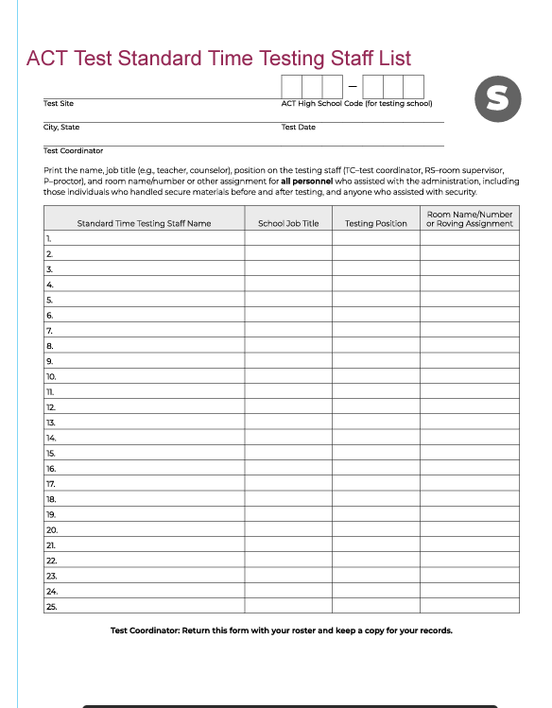

Slide 16
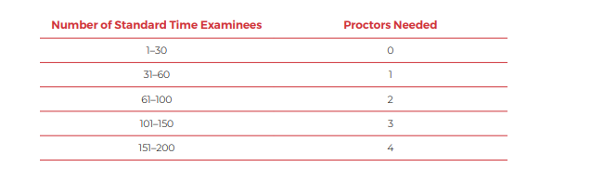
Preparation –
Proctors
Notes:
The proctor requirements are the same as the standard time test. Once you reach 50 students, an additional proctor is required for each additional 50 students.

Slide 17
Preparation –
Test Room Setup
Students should all face the same way
Students should be at least 3 feet apart
Carrels are not allowed
Remove visual aids
Specifics for desks, tables by type, etc.

Slide 18
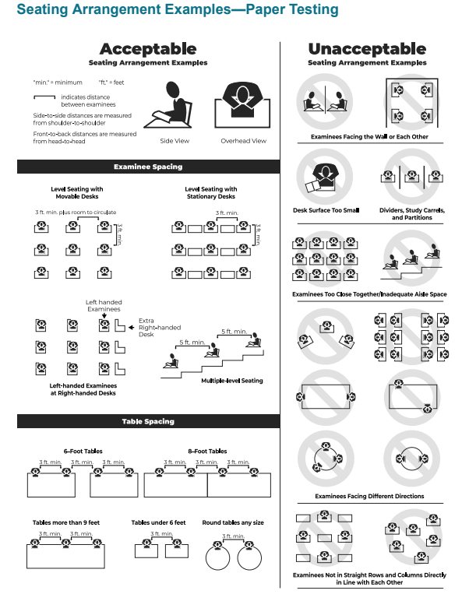
Page 8

Slide 19
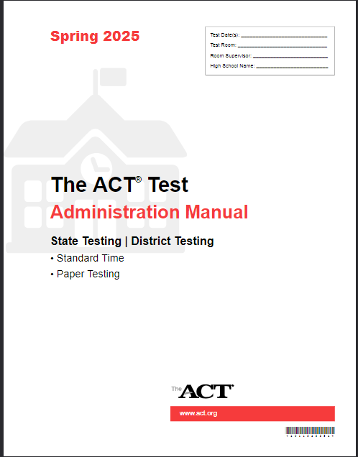
Preparation –
Materials
Make sure you are using this manual for all timing scripts and directions!

Slide 20
Preparation –
Materials
Test materials are sent for a specific date and type (regular or NCR).
Schools must ensure they use correct materials during the test window
Secure
  Test Books
Non-Secure
  Barcode labels
  Answer documents
  Applicable supplements (i.e. Calculator Policy)
  Site Header
  Administration manuals
  Return materials

Slide 21
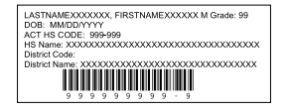
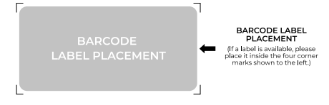
Preparation –
Materials
Check barcode correctness – if incorrect, manually grid the correct student code in Block U
Apply barcode in the correct location

Slide 22
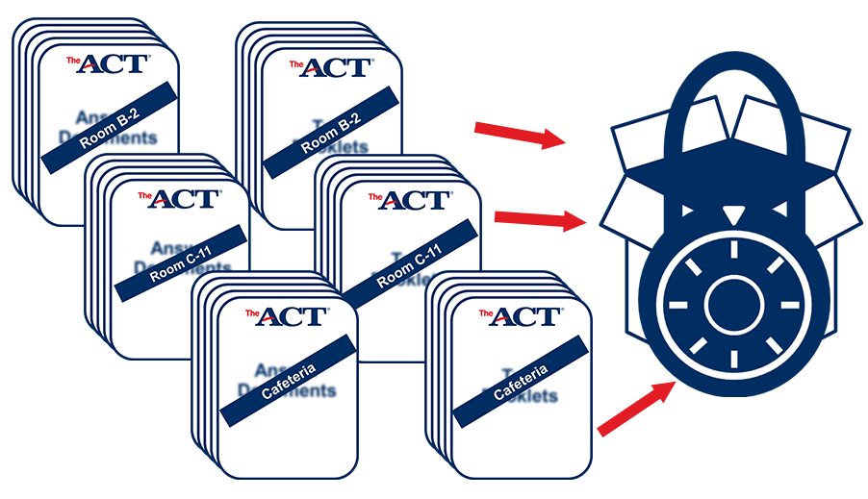
Preparation –
Room Materials
Testing Manual (contains irregularity report)
Test Room Report with test site, room info & roster
ACT Attendance form
Answer documents and test booklets by room
Seating Chart
Approved calculators
Pencils & erasers

Slide 23
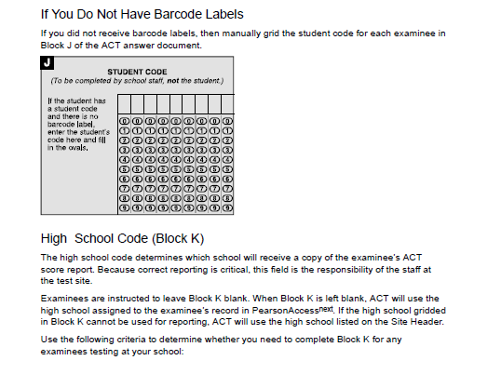
Preparation –
Materials

Slide 24
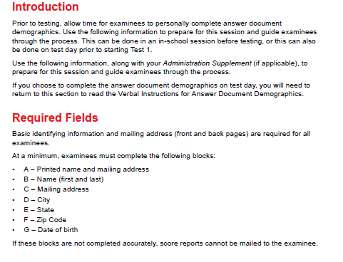
Preparation –
Non-Test Portions

Slide 25
MyACT
Student login information is found in Pearson ACT
In “Reports” -> “Published Reports”
Select “Student Code Usage Status” to view student logins and completions
MyACT
Non-Test Information:
  Examinees will complete additional non-test information online through MyACT. You may choose to schedule an in-school session to complete this portion or you may inform examinees that they can complete the non-test information on their own. Provide examinees with a personalized Non-Test Instructions for Student form and the Taking the ACT State Testing and District Testing to assist them in completing the non-test information online. Refer to the Non-Test Instructions for Test Coordinators for information on completing the non-test information online and hosting an in-school session.

Slide 26
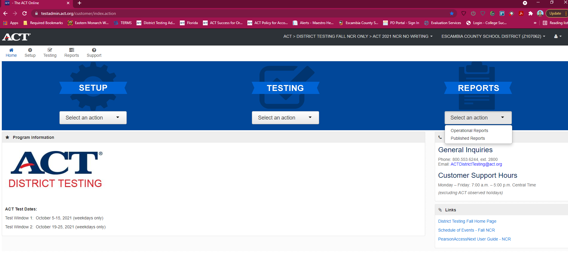
Student Logins
www.testadmin.act.org

Slide 27
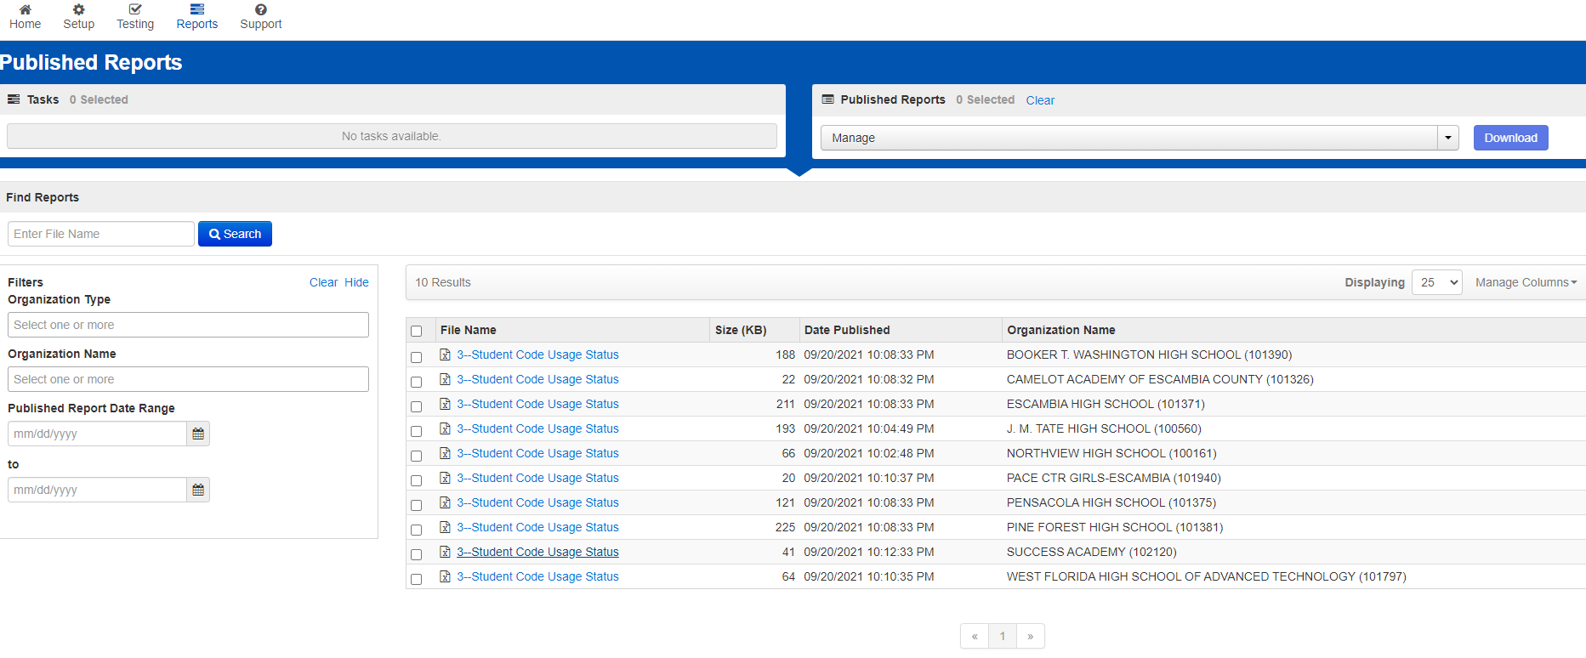
Student Logins
ACT>FLORIDA>ACT SPRING 2025

Slide 28
Test Day –
Guidelines
Tests MUST be taken in order –
  Test 1 – English
  Test 2 – Mathematics
  Test 3 – Reading
  Test 4 – Science(must take for Reportable)
175 minutes of test time + 15 break = 190 minutes (minimum)
Notes:
Can move on once all students have finished that session – Eng (70), Math (90), Reading (55), Science (55)

Slide 29
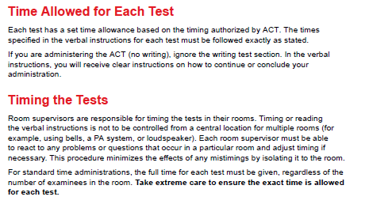
Test Day –
Timing Options

Slide 30

Timing
ACT requires that you allow a 10-15 minute break at the end of Test 2. Each room supervisor is to begin the break at the end of Test 2 as dictated by individual testing activity in the room. Do not attempt to preset an exact break schedule for all test rooms.

Slide 31
Test Day –
Reminders
Electronic devices are prohibited
Calculators are allowed during the math test only
Collect and pack materials after testing (see manual)
Answer documents must be in the envelope
Include irregularity reports (if any)
Make copies of all admin records to keep on your campus
Return materials to ACT right away
Destroy all unused within 72 hours
Email Heather Rykard when you have shipped your materials

Slide 32
Test Day –
Handling Materials
Room supervisors will pick up materials from SAC
To ensure security of test materials, distribute to examinees ONLY when directed to do so in the instructions, not before
Be sure each examinee receives the answer document with his or her name on the barcode label or the student code gridded in Block U (another way to verify attendance)
Personally hand one test booklet individually to each examinee in sequential serial number order

Slide 33
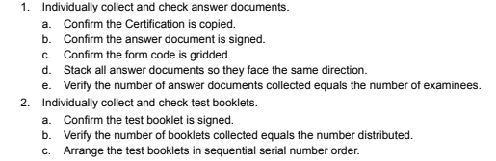
Test Day –
Handling Materials
After Testing, room supervisors must:
*Also remind Room Supervisors to ensure that students fill/bubble in name
And grade level

Slide 34
Test Day –
Irregularities
Fill out the Irregularity Report for each occurrence of a group or individual irregularity (if there are none, do not submit IR)
Group
  Missing or stolen test materials
  Interruptions or disturbances
  Emergency evacuations
  Power outages
  Reschedules
  Pages 32-33 manual
Individual
  Pages 33-38, manual

Slide 35
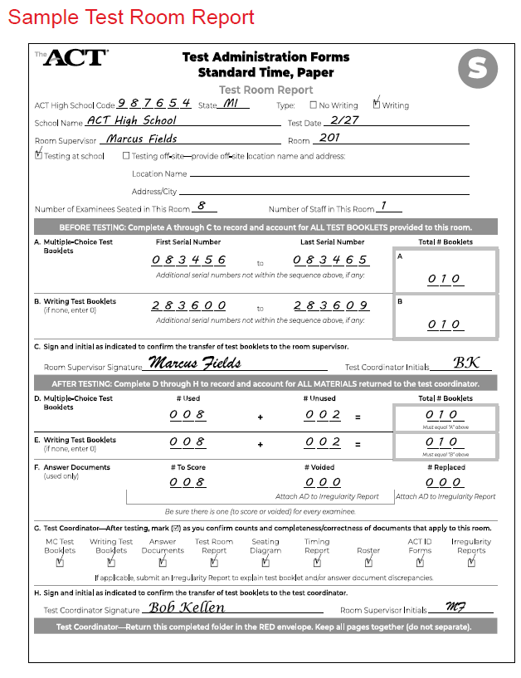
Test Day – Room Report

Slide 36
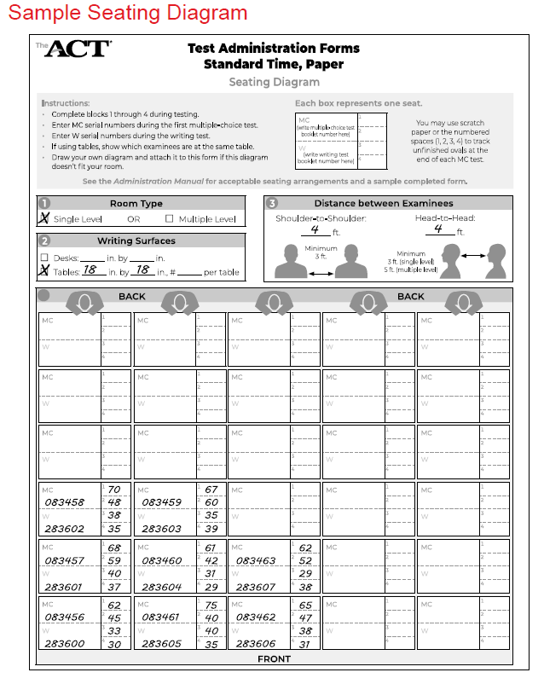
Test Day – Seating Diagram

Slide 37
After Testing
Mark on your testing file which students tested/did not test
ONLY use column marked “Tested? Yes/No”
Do NOT edit/delete/add anything else to this file!

Slide 38
After Testing
Once you have tested, you may ship back all test materials – do not hold them at your schools
ACT will report scores at 4, 7 & 9 weeks – so the sooner your materials are returned, the sooner you MAY see your scores
Deadline for test file update is WEDS, MARCH 5th

Slide 39
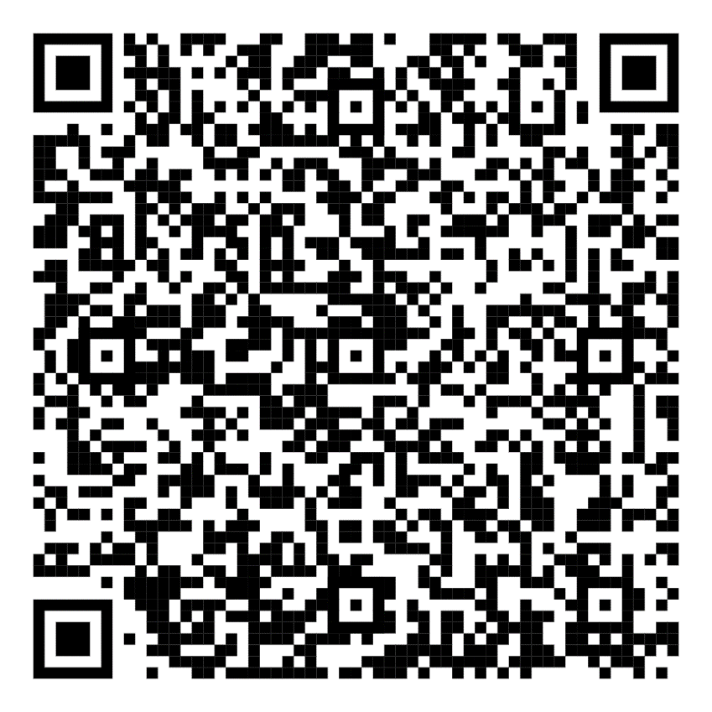
Resources

Slide 40
Resource Videos
Review Step 4: Preparation and Step 5: Administration
Test Day Overview Room Supervisors - Test Day for RS
Returning Test Materials - Returning Materials

Slide 41
Questions
Contact Evaluation Services
  Heather Rykard (Test Procedures, Administration, Accommodations)
    850-469-5387
    hrykard@ecsdfl.us
  Scott Dodson (Pre-ID, Testing Data files, Score reporting)
    850-469-5389
    sdodson@ecsdfl.us

